Slide 1
Characterization of Standard Cell Library
EC383
Ayush Saran
Maji Soma Varun
Subham Mohapatra

Slide 2
Abstract
The aim of the project is to characterize a standard cell library using open source VLSI tools.
The Standard Cell Library comprises basic combinational gates, of varying drive strengths (1x, 2x, 4x).
Characterization of the Timing and Internal Power Characteristics of the cells are performed
Merging our customized library with OpenLANE.

Slide 3
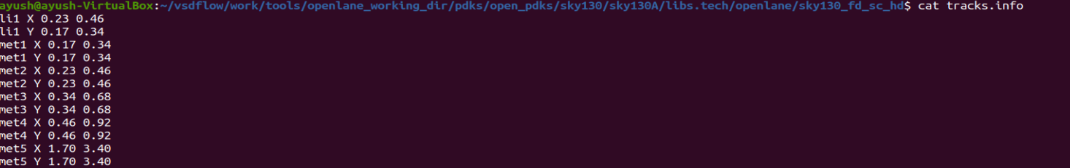
Creating Layouts using Magic
Used the layouts of the cells in sky130_fd_sc_hd library to design our layouts.
Unit Inverter was taken as a reference to determine the necessary parameters.
Referred to tracks.info file in pdks/open_pdks/sky130A/libs.tech/openlane/sky130_fd_sc_hd directory. Referred to metal and interconnect layer parameters, as shown below:-

Slide 4
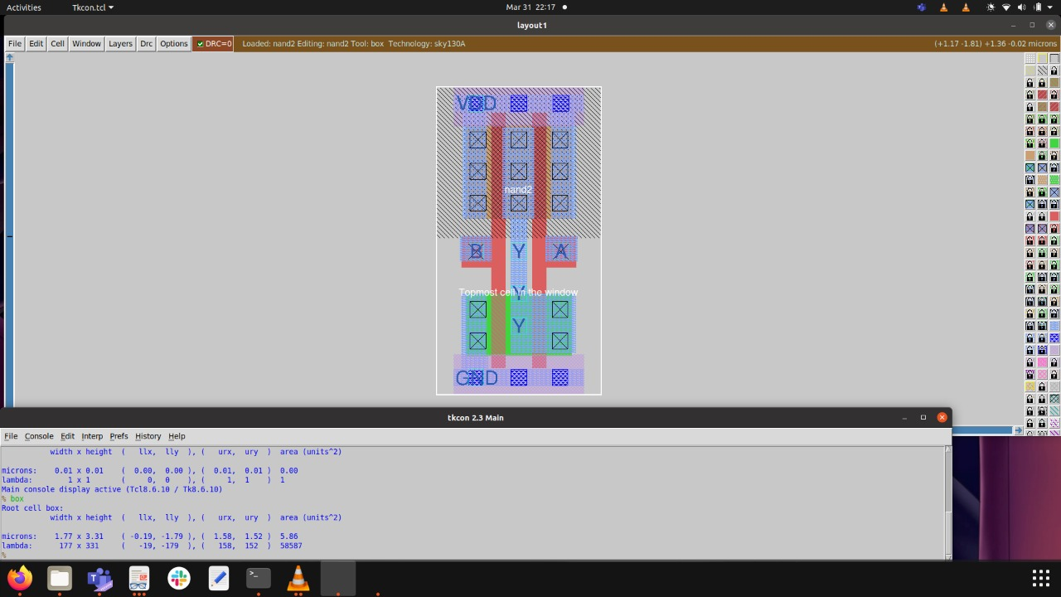
Exemplifying the NAND (nand2_1) gate, designed by us from scratch -

Slide 5
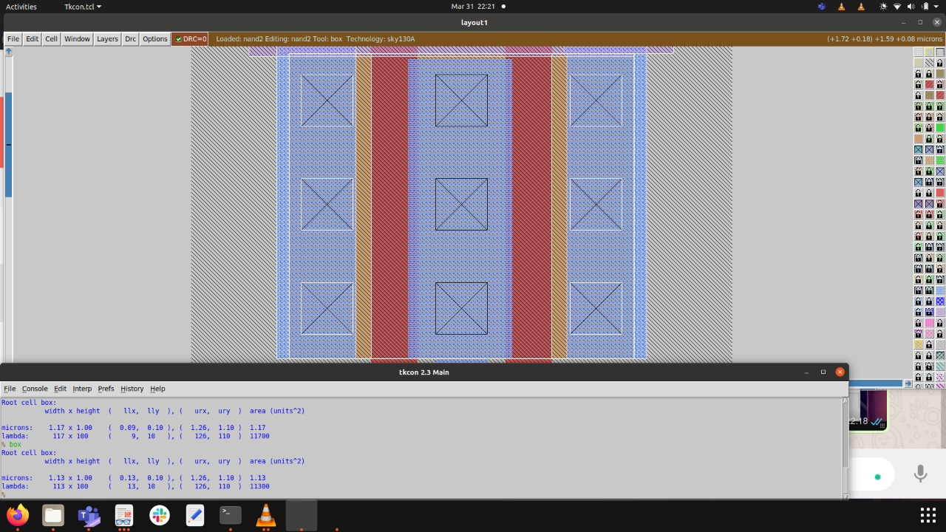
Important Parameters to consider for design -
1. Width x Height = 1.77 x 3.33
2. Area = 5.86
3. Width of :- i) PMOS - 1 micron. ii) NMOS - 0.66 micron.

Slide 6
Finishing off the Design …
Export the PORTS (Y, A, B, VDD, GND respectively)
Extracted the design into SPICE format, for verification purposes. (removing parasitics)
Verified using ngspice.
Extract LEF files, required for merging with OpenLANE.

Slide 7
Characterization of the Cells
Focussed on solely characterizing timing characteristics.
Internal Power and Timing Characterized.
Internal Power - Rise and Fall Power.
Timing - cell fall, cell rise, rise transition, fall transition,
Timing Type = “Combinational”
Python is used to write a scripting file, invoking ngspice to automate all the steps required to characterise the cells.
Characterized both Internal Power and Timing, for each Standard Cell in our library.

Slide 8
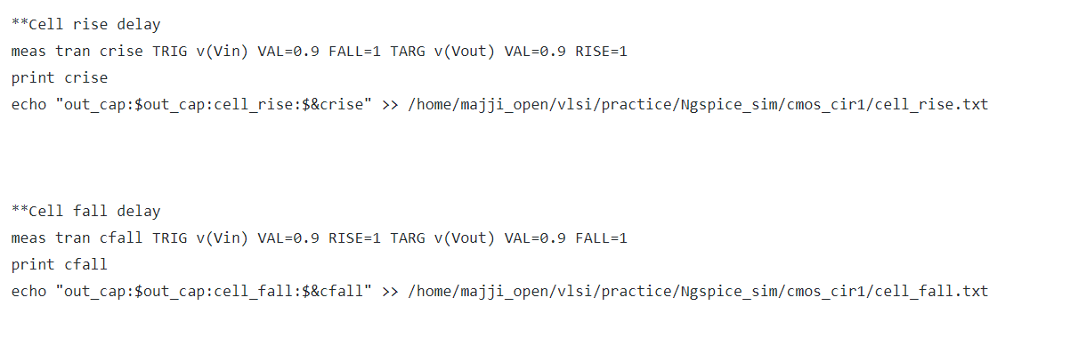
Made use of the “meas” command to compute the necessary timing characteristics. Variables stored in the crise and cfall variables. The results are then compiled and stored in a .txt format.

Slide 9
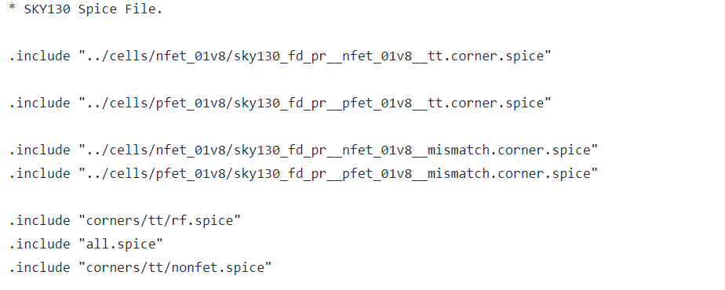
The following Libraries have been included to effectively characterize the timing characteristics of the cells in question. These 7 libraries are invoked throughout the entire spice script.

Slide 10
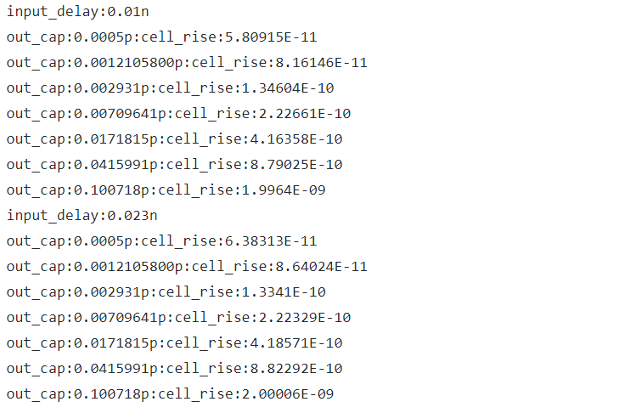
This is the result compiled in the .txt file of the cell rise variable. As observed, the characteristic defined here is per each input_delay defined. We have taken a total of 50 varied input_delay times as parameters for final characterization.
Here, for input_delay = 0.01n, 0.023n, For the given capacitance values, the cell_rise times are computed as shown.

Slide 11
The Characteristics for each Standard Cell
Timing Characterization :-
Cell Rise
Cell Fall
Rise Transition
Fall Transition
Power Characterization:-
Fall Power
Rise Power

Slide 12
Procedure to import standard cell library in openlane

Slide 13
Files required by openlane from a standard cell library
Configuration file
(To define location of liberty file and all necessary lef files)
Lef files
(Used by floorplan, placement and Routing software)
Liberty file
(Used by synthesis,STA,Floorplan and placement software)

Slide 14
Example Run of simple adder cell

Slide 15
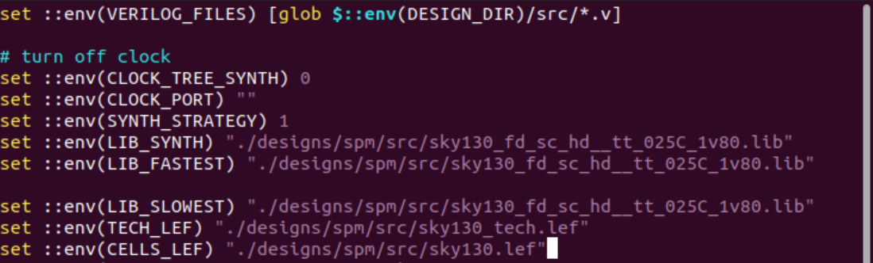
Prepare Configuration File and specify location of liberty and lef files

Slide 16
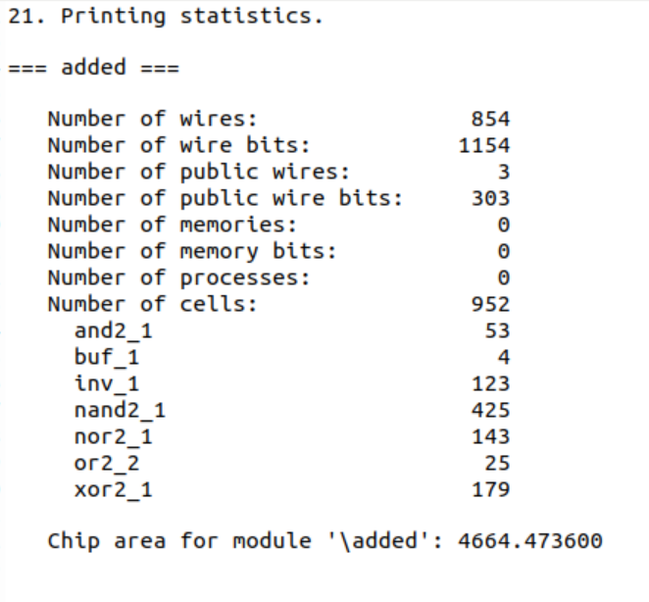
Synthesis Report from yosys

Slide 17
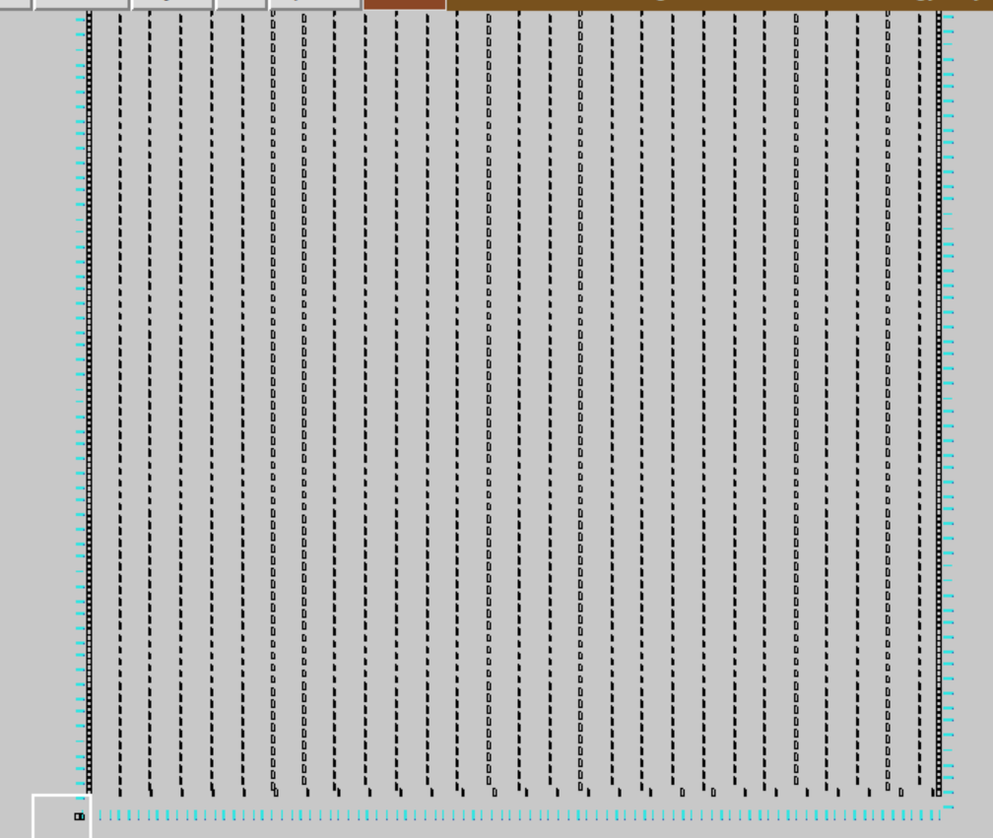
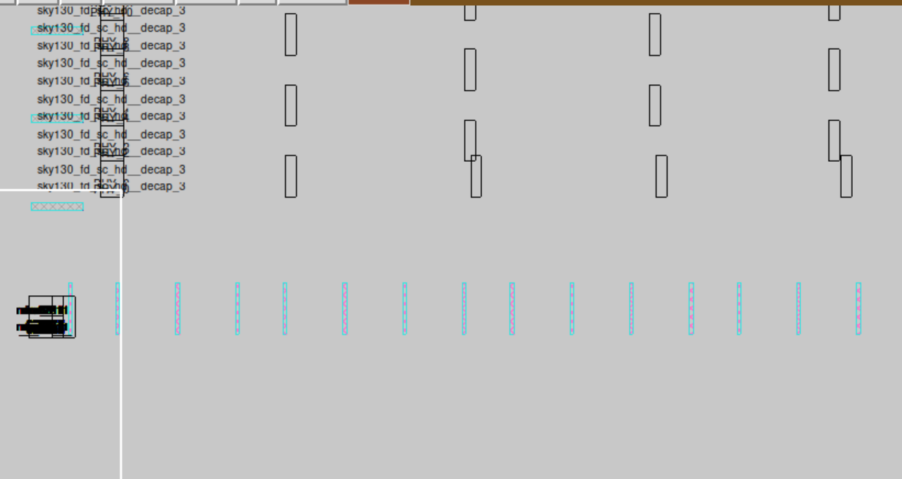
Floorplan stage
Standard cells

Slide 18
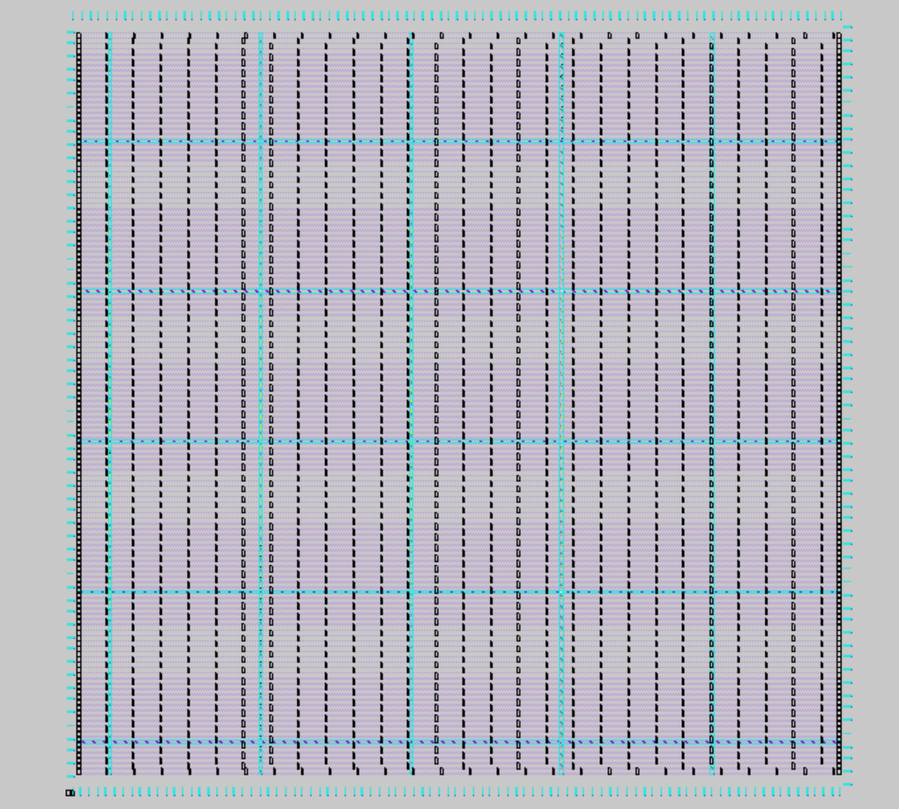
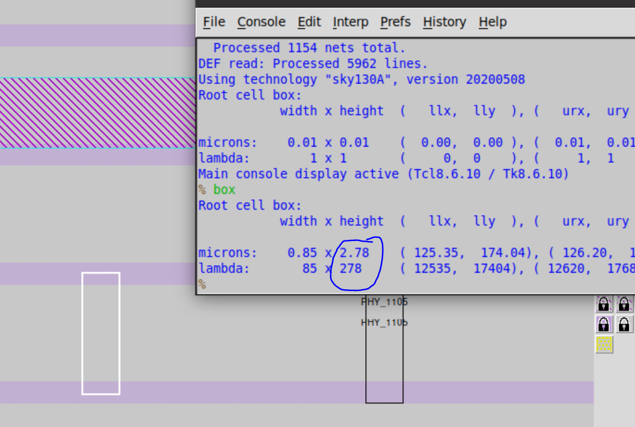
Power distribution network

Slide 19
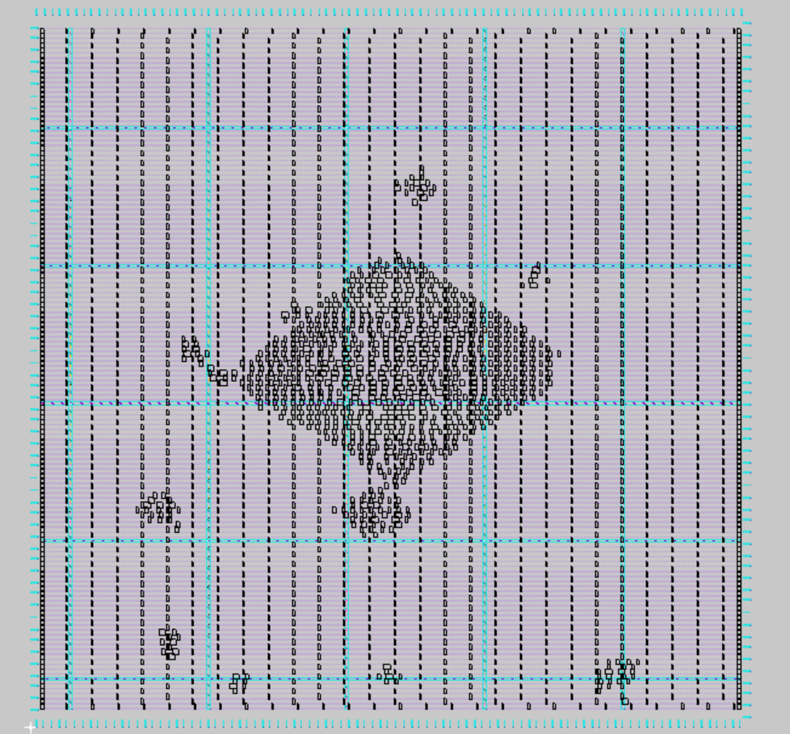
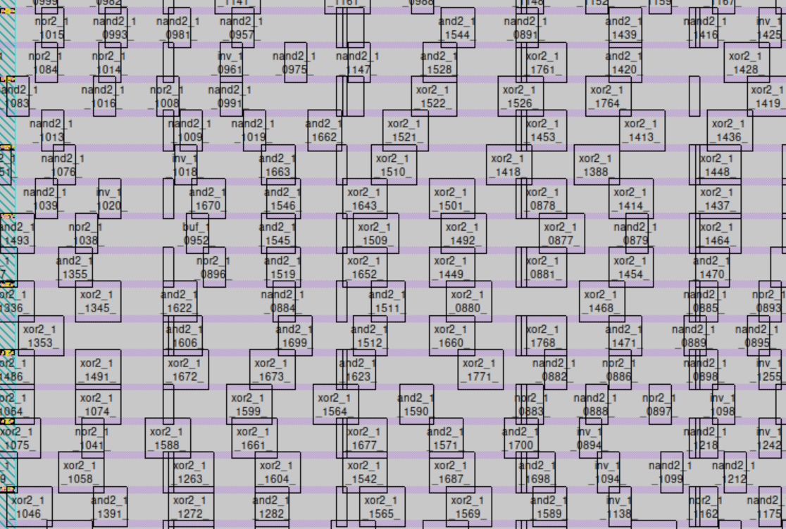
Placement Stage

Slide 20
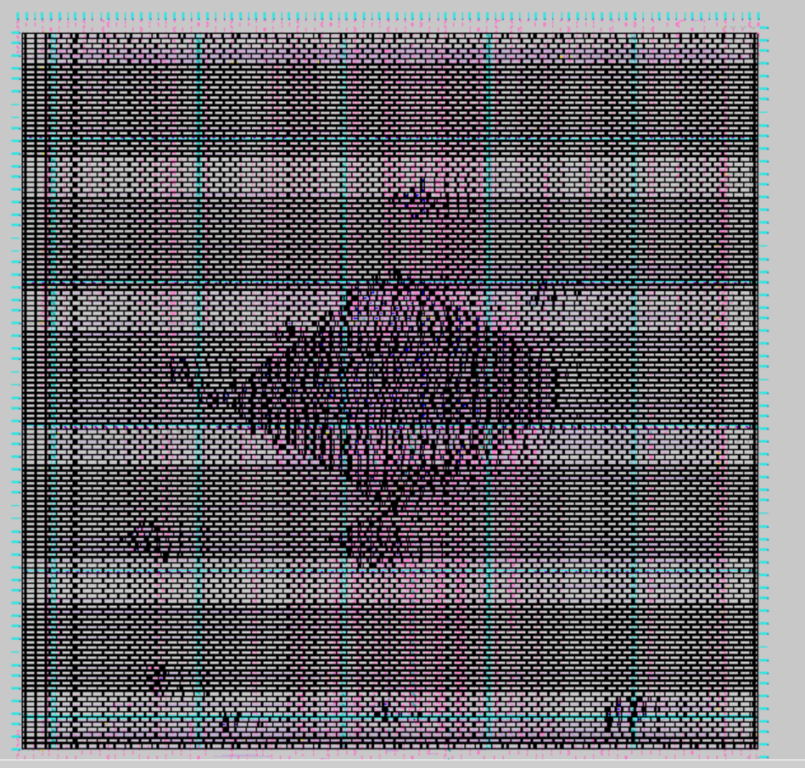
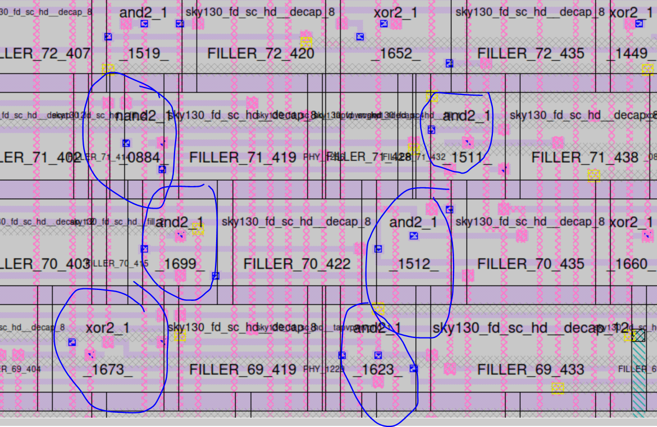
Routing Stage

Slide 21
Literature Survey
http://opencircuitdesign.com/magic/index.html - Used this reference to determine DRC rules and regulations for designing layouts of various combinational cells.
https://github.com/YosysHQ/yosys - Used this to accurately synthesize the netlists for hardware circuits using our standard cell library.
https://github.com/efabless/openlane - Used for post synthesis stages.
http://www.ece.iit.edu/~eoruklu/courses/ece429/tutorial/MAGIC1x.html - For Creating Layouts with Magic.
http://www.iosrjournals.org/iosr-jvlsi/papers/vol4-issue1/Version-1/F04112933.pdf - Characterization of Standard Cells.
https://shareok.org/bitstream/handle/11244/10182/Anne_okstate_0664M_11266.pdf?sequence=1 - Design and Characterization of Standard Cells.
https://skywater-pdk.readthedocs.io/en/latest/contents/libraries/foundry-provided.html - Used for understanding the sky130 standard library.

